Slide 1

Adventure Works 2019
Sick Leave By Job Title Presentation
Notes:
This presentation forms part of a comprehensive analysis demonstrating the process of data cleansing, grouping, and transformation using SQL. Additionally, it showcases how Python was employed to structure, analyse, and summarize key findings, ensuring meaningful insights derived from the dataset.
(please note that the text in bold are my speaker notes & additional info)

Slide 2
Q. What is the relationship between sick leave and Job Title?
Company Outline
Sick Leave By Departments
Sick Leave By Gender
Sick Leave By Working Patterns
Sick Leave By Location
Sick Leave By Scrappage
Conclusion
Recommendations
Notes:
The next couple of minutes we will review the following relationship between sick leave and job title

Slide 3


Introduction
Data Time Frame
Geographical
Working Patterns
Employees 296
Leavers 6
Current 290
USA = 98% of employees & 96% of these are located in Washington
Day shift 60%
Afternoon shift 22%
Evening shift 19%
2006 2013
98%
60%
5
Notes:
The data covers a time frame from 2006 & 2013 therefore the issues is not resolving overtime.
Any solution will mainly affect staff based in Washington that work during the day
It is assumed that properties of “Available sick leave” is based on historical data for the dept and continuing trends.

Slide 4
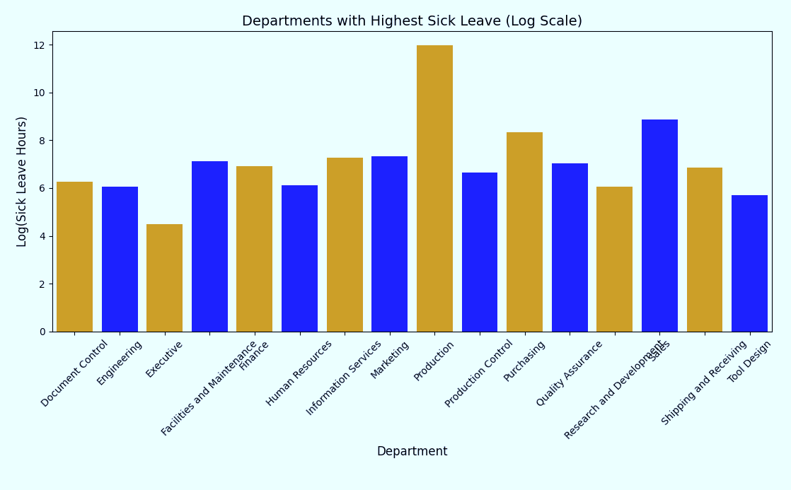
(b) Sick Leave By Department
Notes:
This chart compares departments to sick leave
Production has the highest sick leave hours.

Slide 5
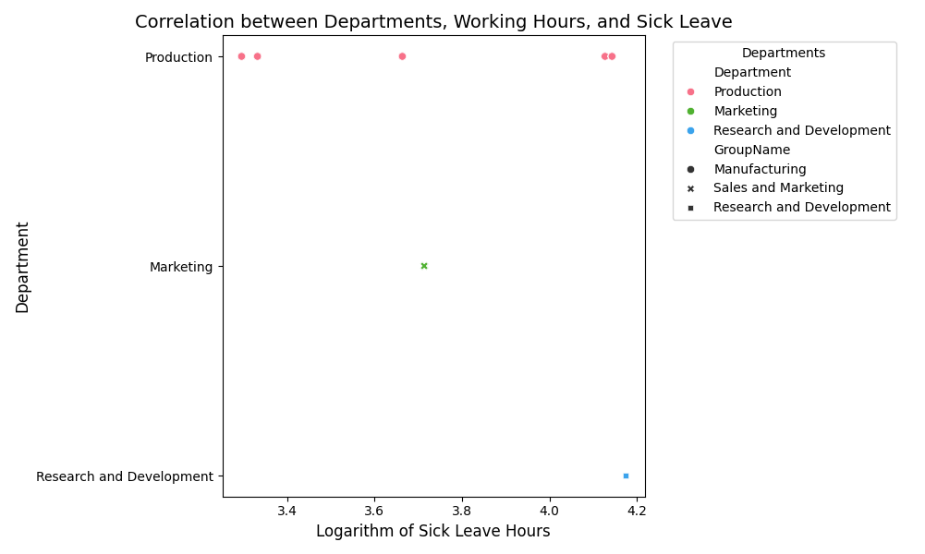
(b) Sick Leave By Department
Working hours for production
Notes:
The image is a bar chart titled "Sick Leave by Working Hours" and shows the correlation between departments, working hours, and sick leave hours.
Here's a summary:
Departments: The x-axis lists various departments, including Production, Marketing, Human Resources, Manufacturing, Sales and Marketing, and Research and Development.
Logarithm of Sick Leave Hours: The y-axis represents the logarithm of sick leave hours.
Key Observations:
Production: This department shows the highest sick leave hours.
Marketing and Human Resources: These departments also have significant sick leave hours, though less than Production.
Manufacturing, Sales and Marketing, and Research and Development: These departments have lower sick leave hours compared to the others.

Slide 6

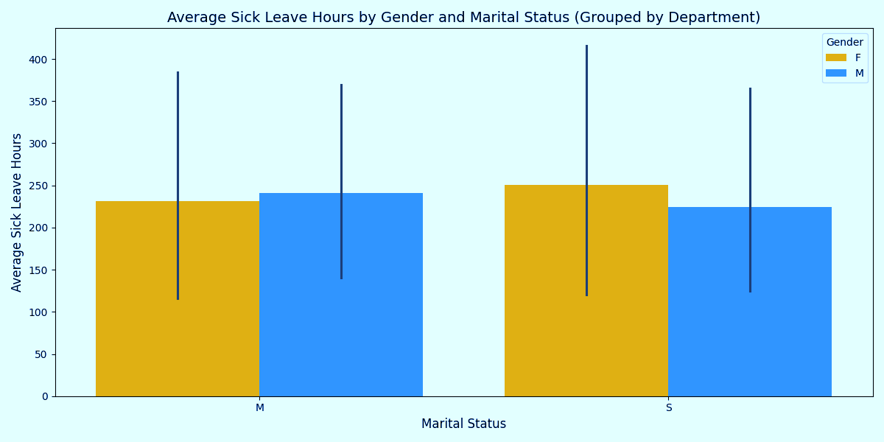
(c) Sick Leave By Gender
Notes:
Key Insights:
Gender Differences:
On average it appears
Among married individuals, females take about 225 hours, while males take closer to 230 hours.
Among single individuals, females take around 250 hours, whereas males take approximately 225 hours
Company wide changes should target both sexes as the bracket in differences is a marginal diff of 20 hours

Slide 7
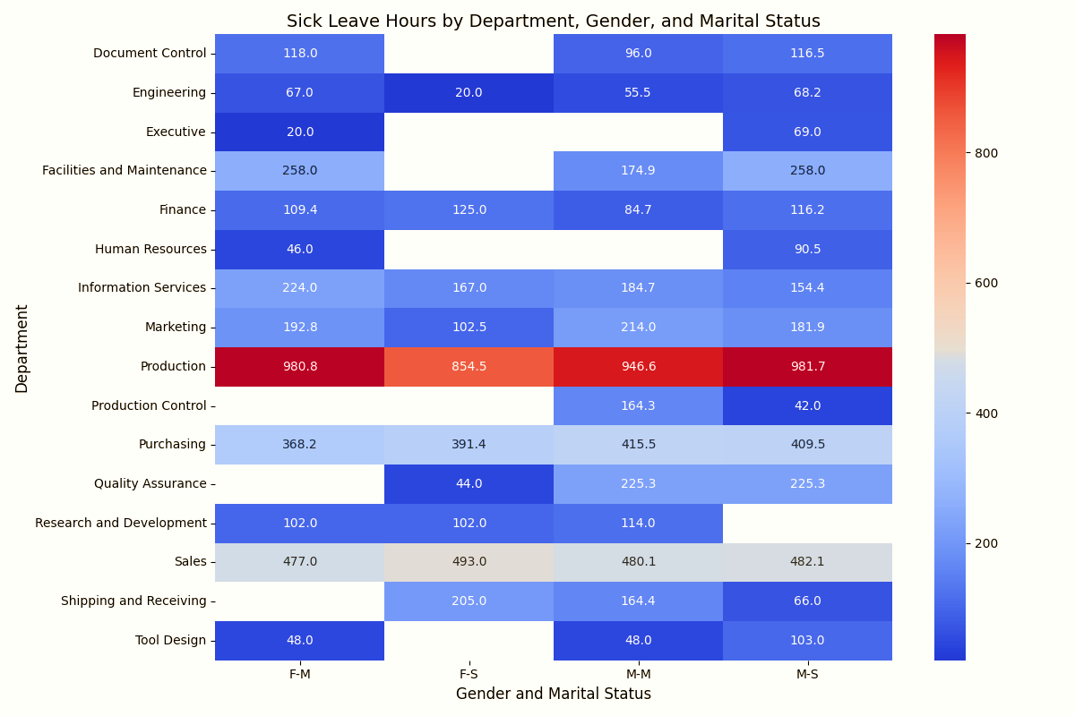
(b) Sick Leave By Department
Notes:
We can further break this down in a heat map:
Looking at departments, gender and marital status.
key insights are:
Production department shows the highest sick leave
With single males being the main contributor
Followed by married females

Slide 8
(c) Sick Leave By Gender
Sick Leave Hours
 | Married |  | Married Total | Single |  | Single Total | Grand Total
Organisation Level | Female | Male |  | Female | Male
CEO |  |  |  |  | 69 | 69 | 69
1 | 20 |  | 20 | 72 | 117 | 189 | 209
2 | 258 | 381 | 639 | 199 | 386 | 585 | 1,224
3 | 366 | 1,085 | 1,451 | 506 | 1,131 | 1,637 | 3,088
4 | 1,520 | 2,796 | 4,316 | 903 | 3,330 | 4,233 | 8,549
Total | 2,164 | 4,262 | 6,426 | 1,680 | 5,033 | 6,713 | 13,139
Notes:
As a company, When looking organisation level.
Married employees contribute more to sick leave
With males being the main focus - at lower level- of the organisation

Slide 9

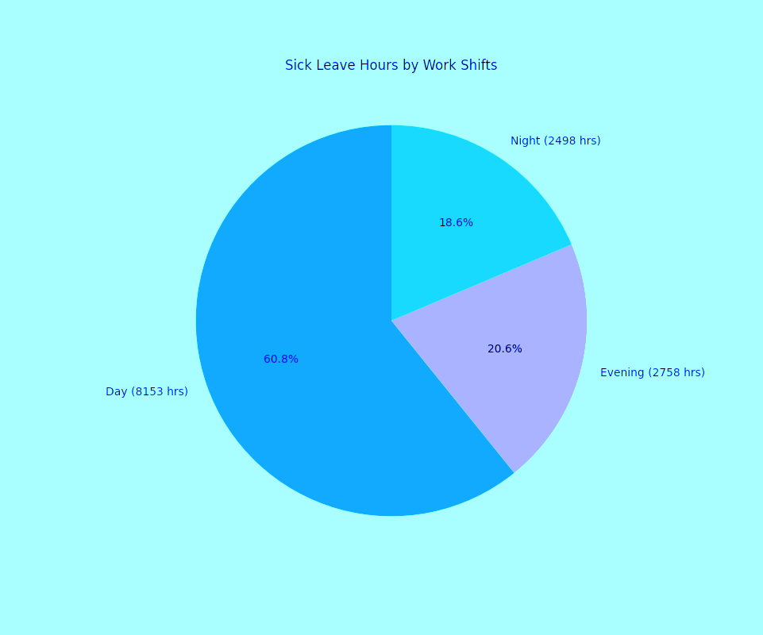




(d) Working Patterns
60%
20%
18%
Day = 60 %
Evening = 21%
Night = 19%
Notes:
This pie graph shows the relationship between working patterns and sick leave
Showing Day shift contribute 60% of sick leave

Slide 10
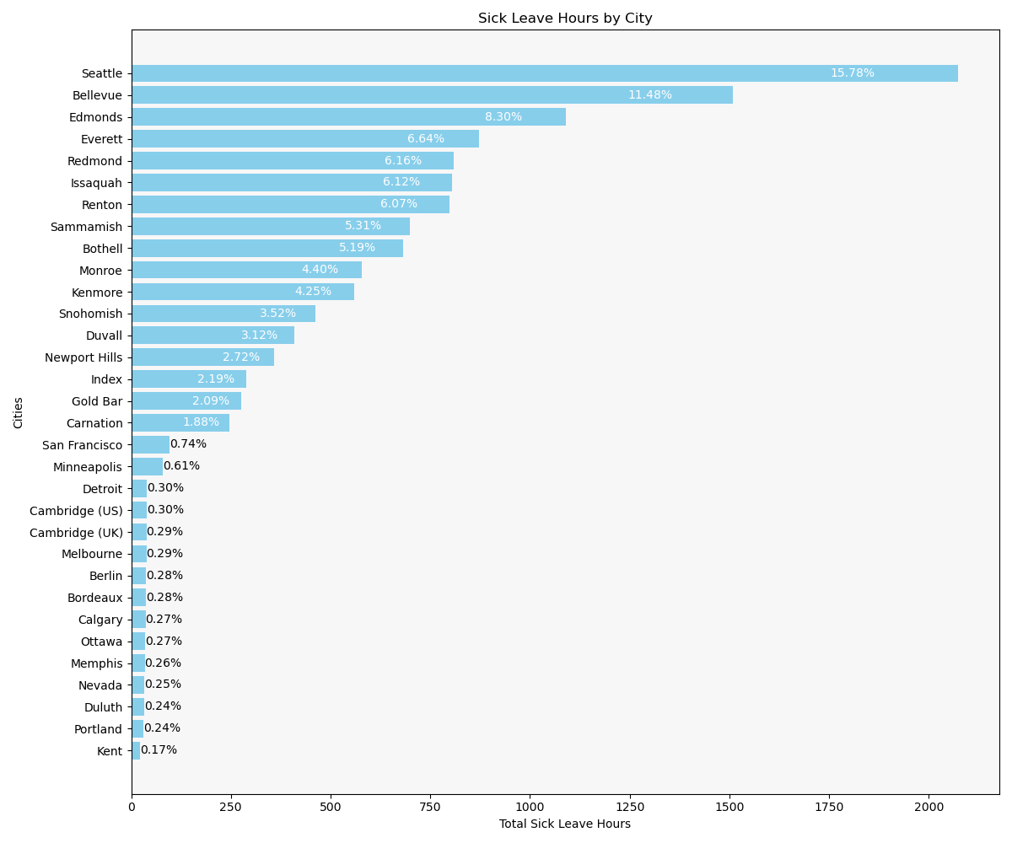
(e) Sick Leave By Location
Notes:
Next, looking at location by sick leave we can see the top 3 contribute 36% of sick leave tackling issues here would have at these sites would have a significant impact
Seattle: Highest sick leave hours at 16%
Edmonds: Second highest at12%
Bellevue: Third highest at 8%

Slide 11
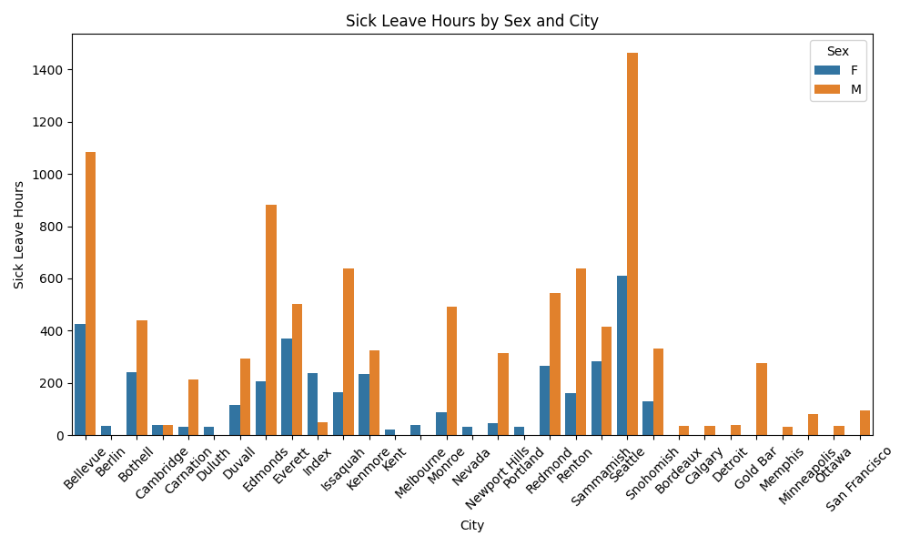
(e) Sick Leave By Location
Notes:
Next, is sick leave by location
top 3 contribute 36% of sick leave
tackling issues at these site would have a significant impact
Seattle: at 16%
Edmonds: at12%
Bellevue: at 8%

Slide 12

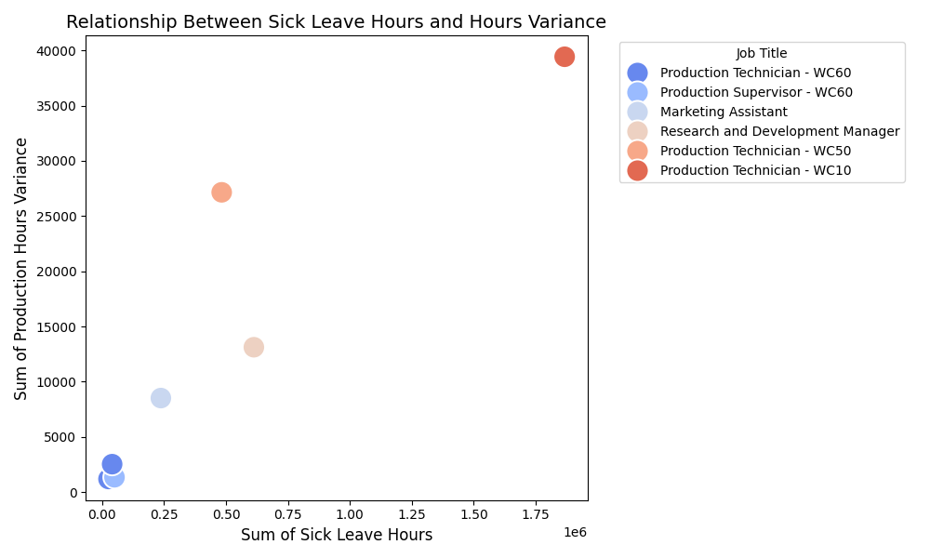
(f) Sick Leave By Scrappage
Notes:
Data here shows the correlation between schedule and actual production variance times
The data shows that sick leave increases when staff are pushed to finish ahead of scheduled start times.
When staff work within schedule time frames the sick leave hours drop rapidly.
Further investigation is required around staff shortages, product demand and management style

Slide 13
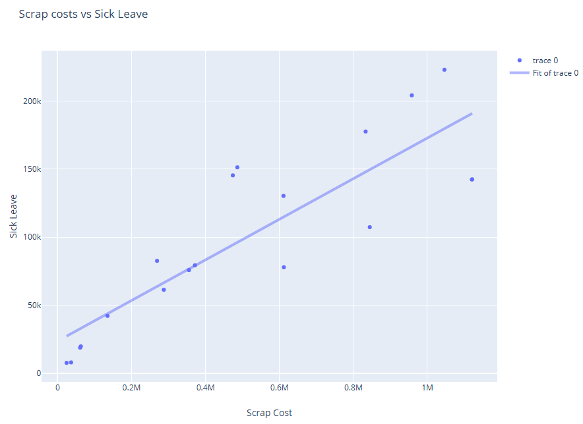
(f) Sick Leave By Scrappage
Notes:
Here we look to see what could be causing the issue in manufacturing
This chart shows the 86% correlation between scrap level and sick leave
Product 813 closely aligns with high scrap levels
This might hint work force issues
High Scrap costs could signify production issues
which might place strain on workers,
leading to more sick leave.

Slide 14
(g) Sick Leave Conclusion
Working Patterns
Location
Seattle: 15.78%
Bellevue: 11.48%
Edmonds: 8.30%
Organisation Level 4
WC60 Product Technicians
WC60 Product Supervisors
Scrappage
Faster Production Time Issue?
Products 945,804,813
Day Shift
Department
Gender
Male
Single
Notes:
To recap areas of interest for HR to investigate
Are:
Manufacturing at Seattle, Bellevue and Edmonds
On production lines of 945,804,813

Slide 15
(h) Sick Leave Recommendations
KPI’s
Scrappage
Sick Leave Hours
Production Schedules
Notes:
Setting KPIs
In scrappage and production schedules should impact sick leave hours.
Issues can be addressed with wellness programs, workload management, and flexible work hours, to improve employee well-being and productivity.
Let's take a proactive steps to create a healthier and more efficient workplace.
I will now hand you over to ..

Slide 16

THANK YOU

